Slide 1


[Social Buzz]
By : Parikshith N K

Slide 2


Today's agenda
Project recap
Problem
The Analytics team
Process
Insights
Summary

Slide 3


Helping Social buzz, a social media
platform to analyze their
top categories by popularity
through aggregate
reaction of users .
Project Recap

Slide 4


Problem
Data of Social Buzz has become
very huge for them to analyze and
hence Accenture comes into picture
to analyze the data to uncover
top categories of their
data by popularity

Slide 5
Andrew Fleming
Chief Technical Architect
The Analytics team
Marcus Rompton
Senior Principle
Parikshith N K
Data Analyst

Slide 6

Data Cleaning: deleting inconsistent values and
formatting data types.
Process
1
Merging different data sets by using Vlookup
function to prepare data for analysis.
2
3
Used Pivot tables to calculate aggregate
score of each category.
4
Arranged the table in Descending order
of scores for categories.
5
Used column chart to
visualize the data.

Slide 7
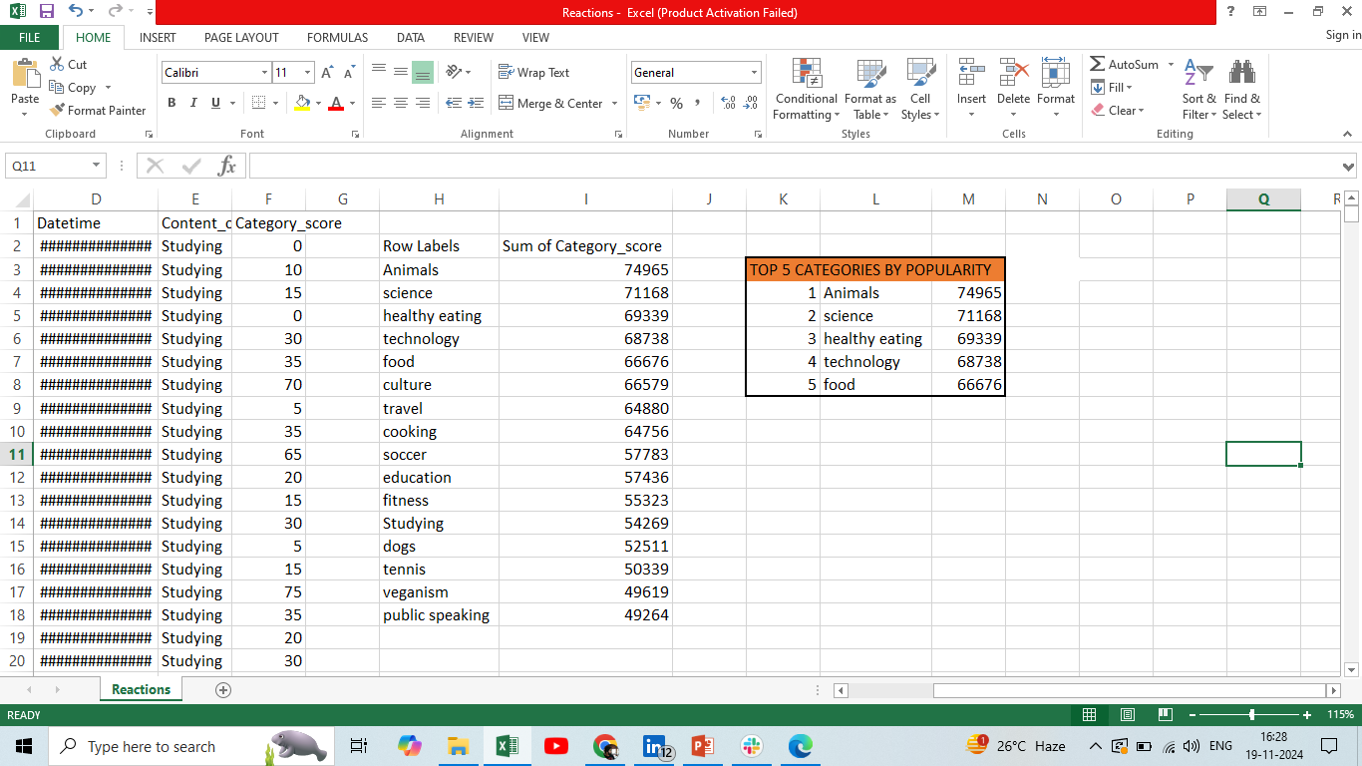


Insights

Slide 8
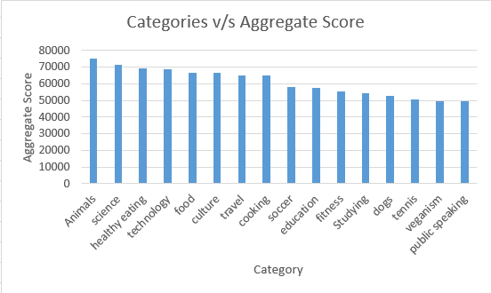

Slide 9


Accenture’s analysis has
helped Social Buzz company
to prioritize their
categories in their huge
data and indeed helps it to
take viable decisions
in future.
Summary

Slide 10

Thank you!
ANY QUESTIONS?

